Slide 1

ROBOT LOCALIZATION VIA VISUAL ODOMETRY
Abdullah Enes BEDİR
Recep Salih YAZAR
Burak Dursun KULAKSIZ
Project Advisor: Dr. Tankut AKGÜL
07.02.2022

Slide 2

CONTENT
INTRODUCTION
LITERATURE REVIEW
Traditional Methods
Learning Based Methods
IMPLEMENTATION
Feature detection
Feature Tracking
Demonstration
RESULTS AND EVALUATION
CONCLUSION

Slide 3
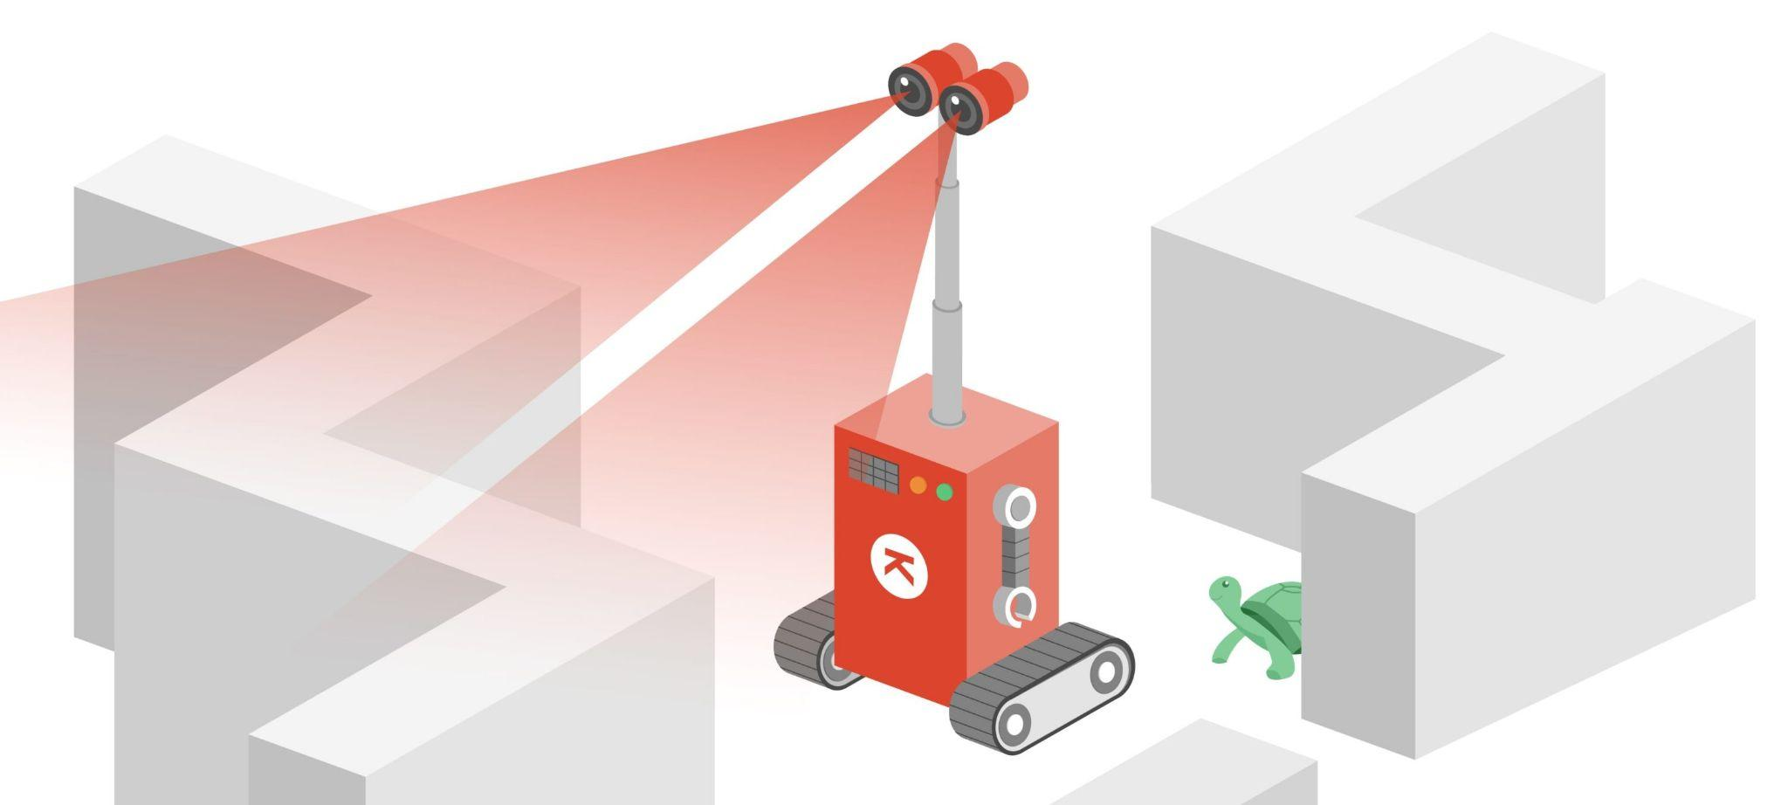
What is Visual Odometry?
The Pose Estimation Process
Vehicle, Human, and Robot
A Single or Multiple Cameras
Analyzing the Image Sequences

Slide 4
Why Visual Odometry?
More Accurate than Conventional Techniques
Error Ranging from 0.1 to 2%
Straightforward and Inexpensive Method
Data isn’t Lost Like in GPS Applications

Slide 5
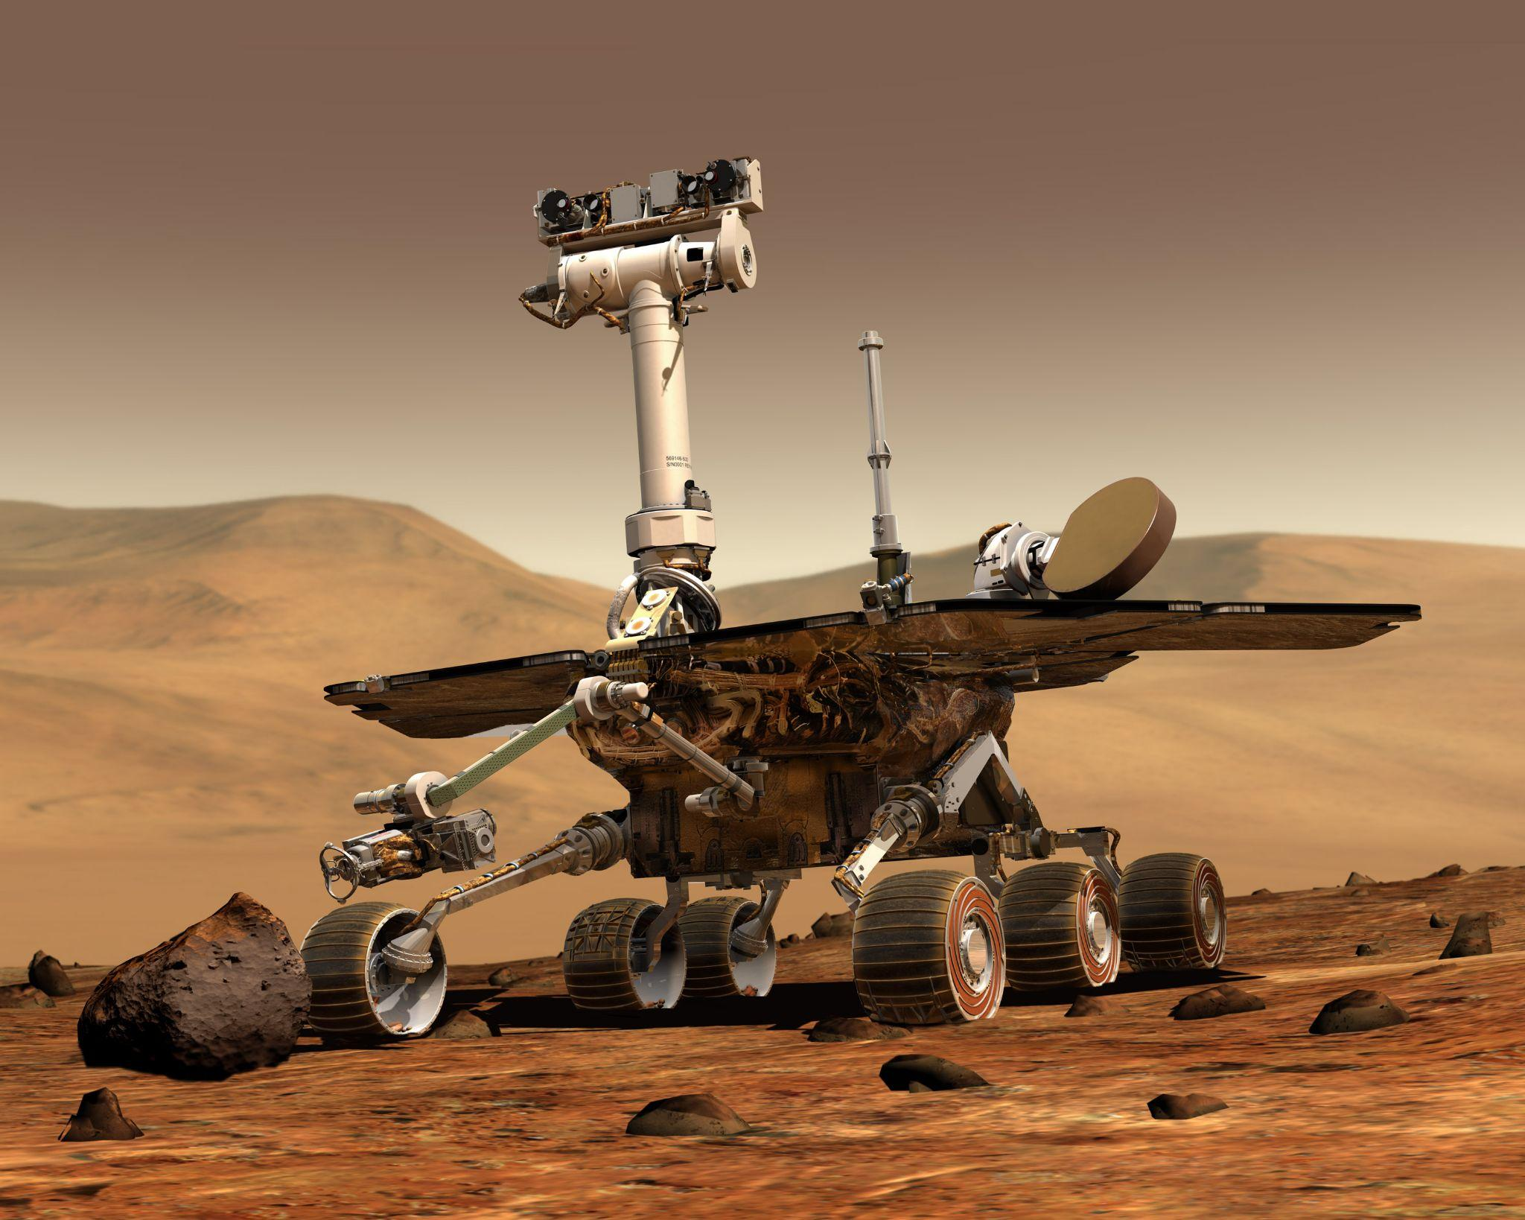
Visual Odometry Applications
Robotics, Automotive, and
Wearable Computing
Ground, Underwater, Aerial, and
Space Robots
The NASA Mars Rovers
Unmanned Aerial Vehicles (UAVs)

Slide 6
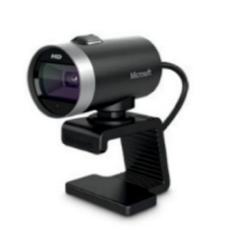
Monocular Visual Odometry
Monocular and Stereo Camera, RGB-D,
Stereo/Monocular Omnidirectional
Scale-uncertainty
Five-point Relative Pose Estimation Technique
Provide Better Results with Data from Other Sensors.

Slide 7
LITERATURE REVIEW
Traditional Methods
Learning Based Methods

Slide 8
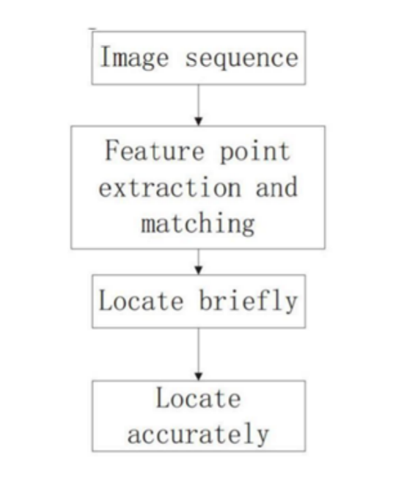
The Feature-Based Method
Extracts the Lines, Corners, and Curves of
the Images
Image Frame Sequences
Uses Velocity Vectors to Compute Displacement
Matching the Feature Points

Slide 9
Learning Based Methods
Introduction to Machine Learning
Learning Method with PoseNet
Learning Method with FlowNet

Slide 10
Introduction To ML
Subfield of Artificial Intelligence
Datasets
Computer Learn Automatically

Slide 11
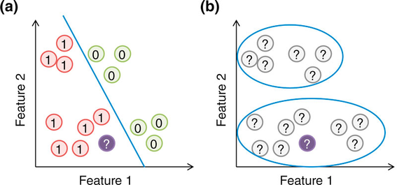
Introduction To ML
Supervised Learning
Unsupervised Learning
Reinforcement Learning

Slide 12
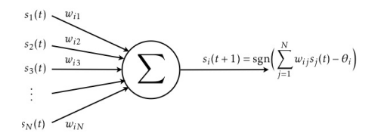
Neural Networks
Neurons
Activation Functions
Loss Functions

Slide 13
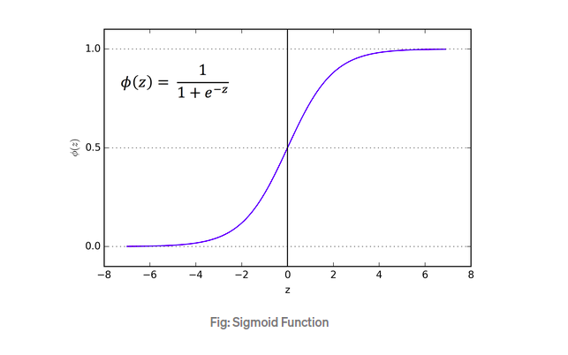
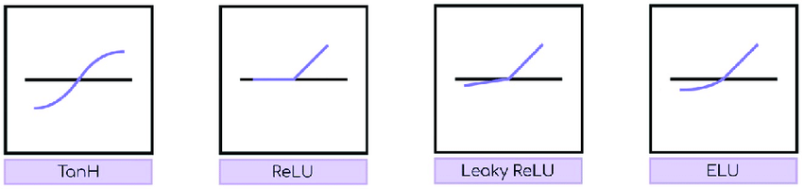
Activation Functions

Slide 14
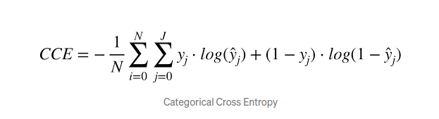
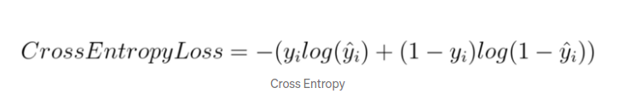
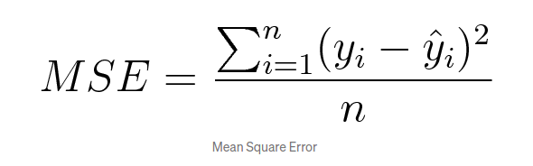
Loss Functions
Notes:
https://machinelearningmastery.com/how-to-choose-loss-functions-when-training-deep-learning-neural-networks/

Slide 15
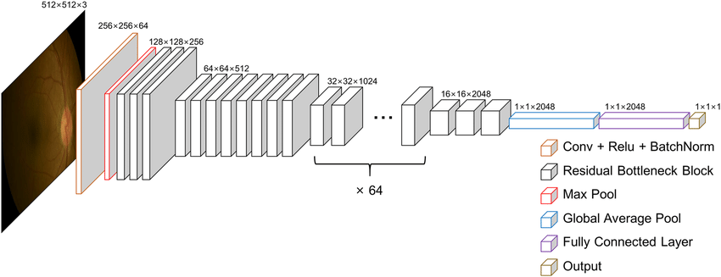
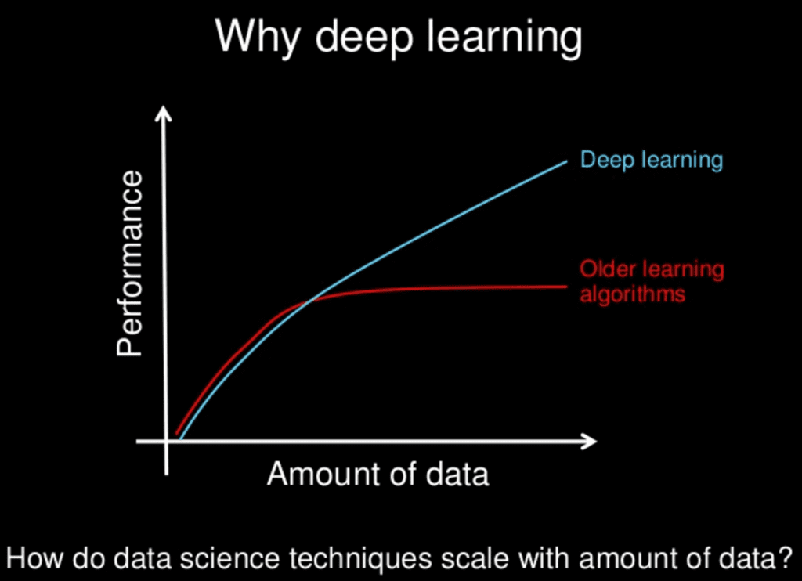
Deep Learning
Subfield of Machine Learning
Complicated Datasets
Convolutional Neural Networks

Slide 16
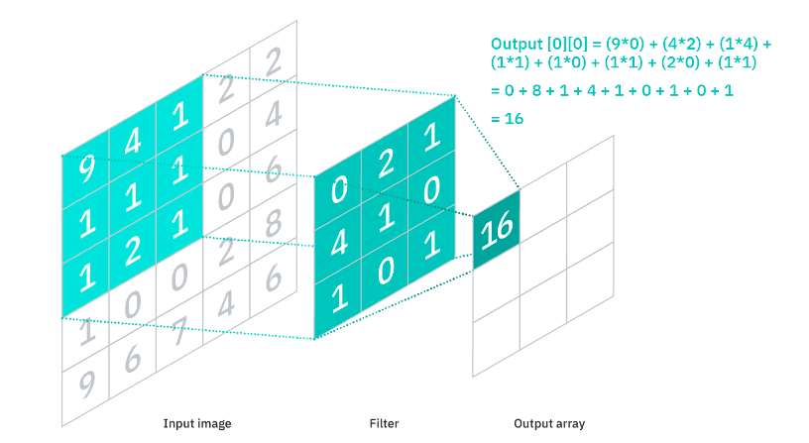
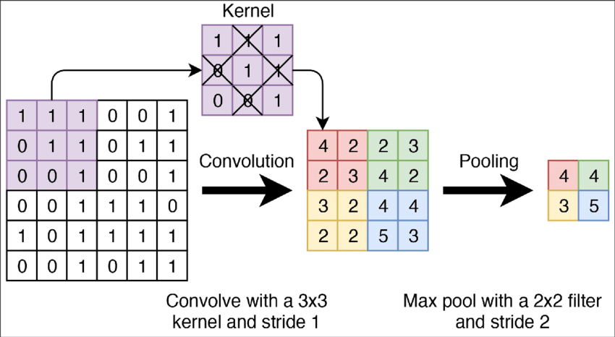
Convolutional Neural Networks
Convolutional Layers Pooling Layers

Slide 17
Learning Method with Pose Net
Unsupervised Scale-consistent Depth Learning from Video
Depth Network
Pose Network

Slide 18
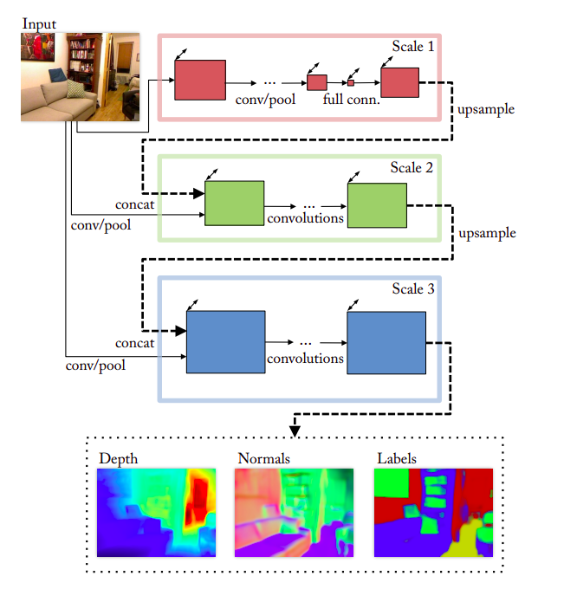
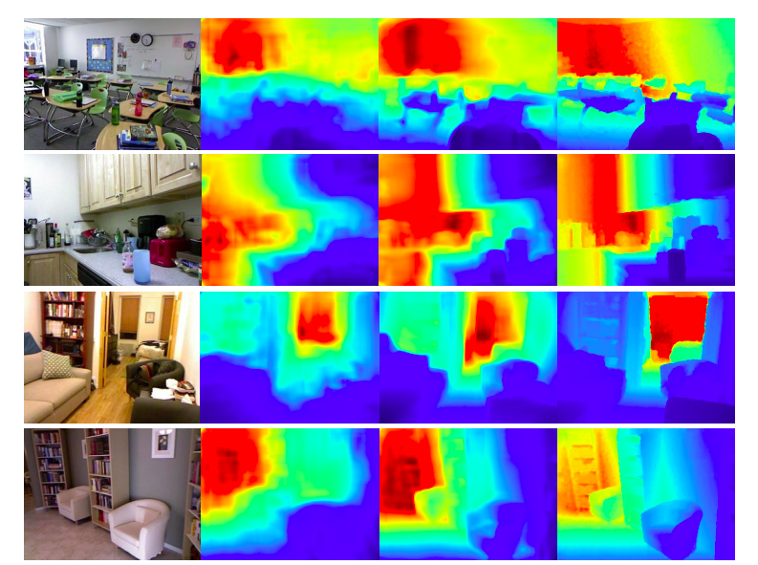
Depth Network
Predict Depth
Convolutional Architecture
SuperVised Learning
Notes:
https://sci-hub.se/10.1109/cvprw.2018.00066
https://ieeexplore.ieee.org/document/8575528
Predicting Depth, Surface Normals and Semantic Labels with a Common Multi-Scale Convolutional Architecture
Figure 2. Example depth results. (a) RGB input; (b) result of [8]; (c) our result; (d) ground truth. Note the color range of each image is individually scaled.

Slide 19
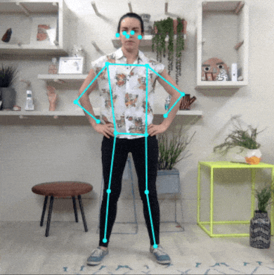
Pose Network
Pose Estimation
6 - DoF Pose
Supervised Learning
Notes:
https://www.tensorflow.org/lite/examples/pose_estimation/overview
https://medium.com/globant/posenet-your-gateway-to-gesture-detection-a15d0ed0ae40

Slide 20
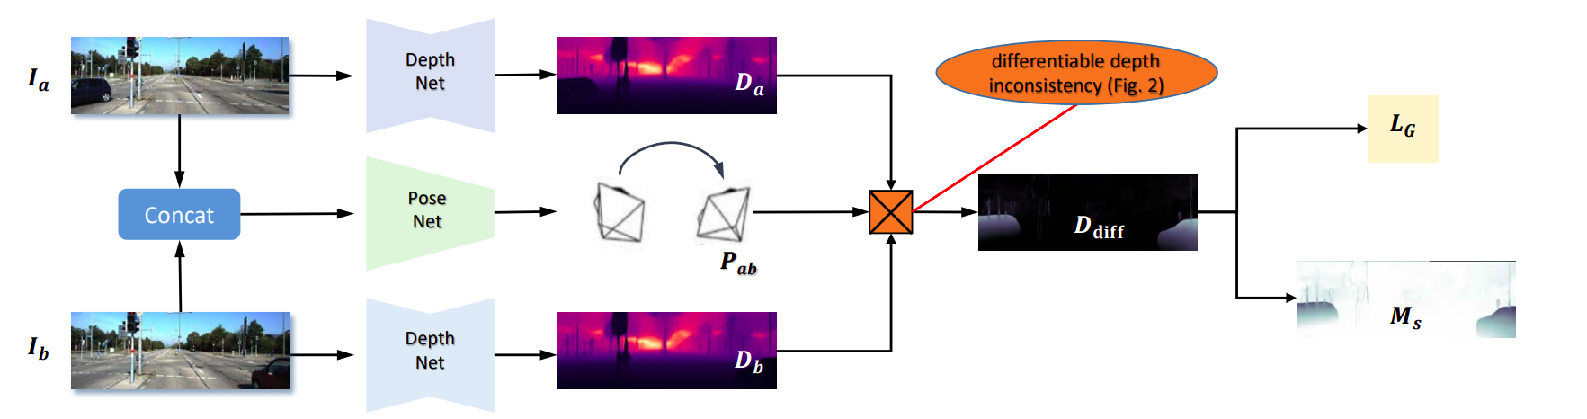
Learning Method with Pose Net
WHOLE UNSUPERVISED PROCESS

Slide 21
Learning Method with Flow Net
Towards Better Generalization: Joint Depth-Pose Learning without PoseNet
Flow Network
Depth Network

Slide 22
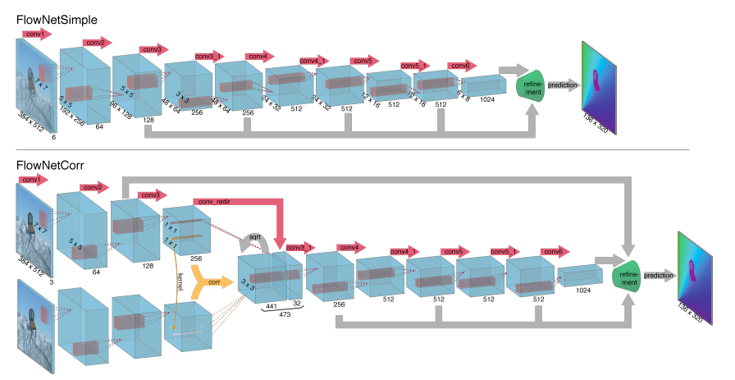
Flow Network

Slide 23
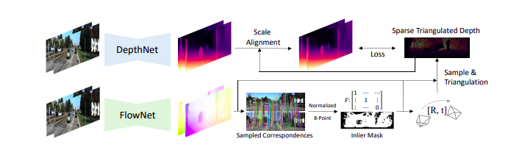
Learning Method with Flow Net
WHOLE STRUCTURE

Slide 24
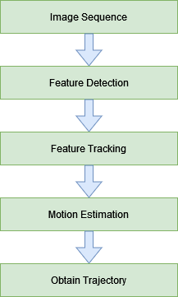
IMPLEMENTATION
Traditional methods were preferred.
To learn the mathematical background.
They are cost-effective compared to learning based ones.

Slide 25
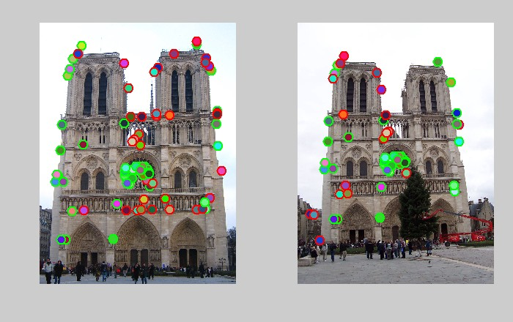
Feature Detection
Features may be specific structures in the image such as points, edges or objects.

Slide 26
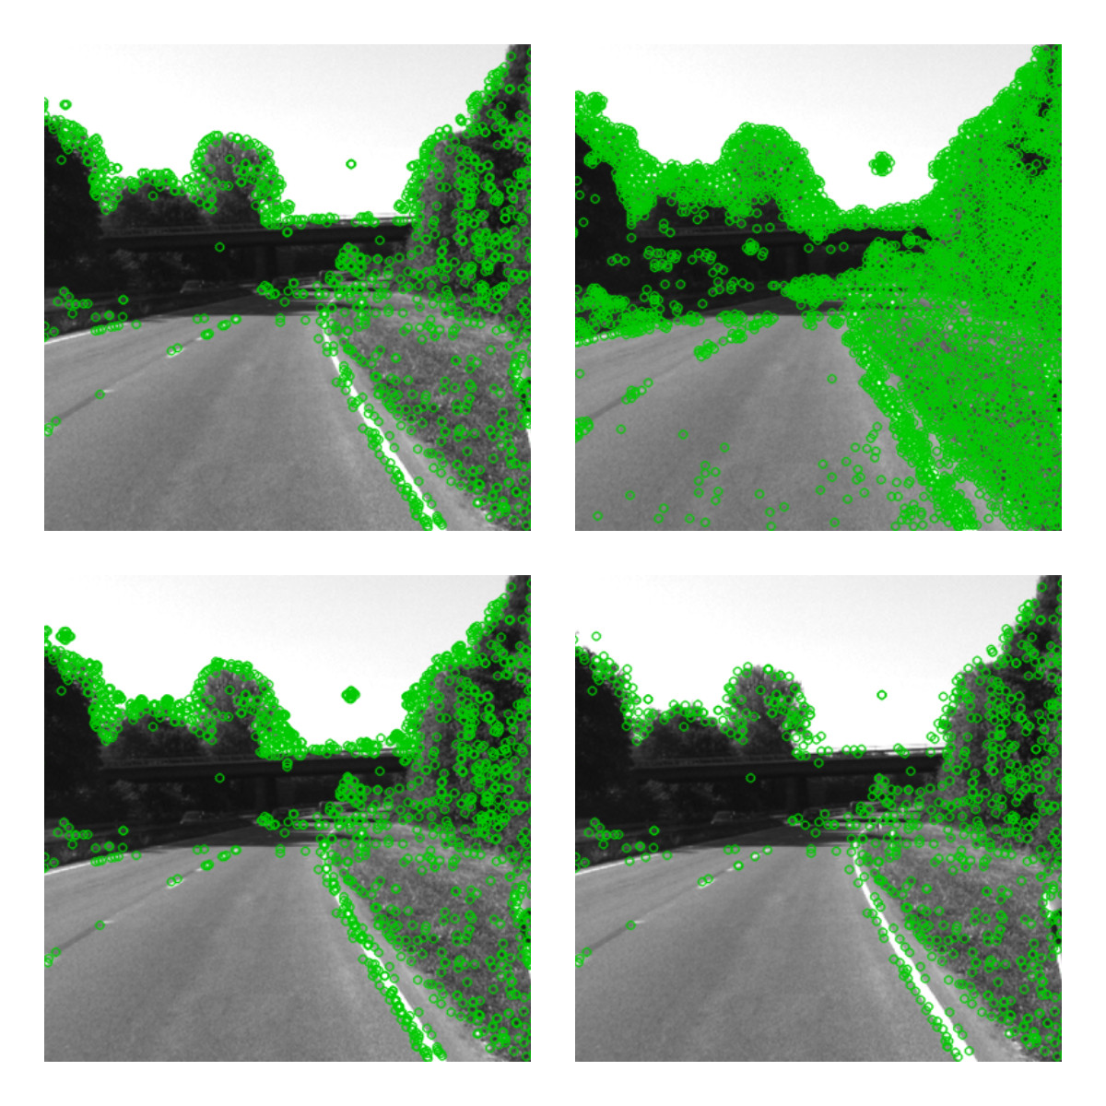
Feature Detection Algorithms
SIFT (Scale-Invariant Feature Transform)
FAST (Features from Accelerated Segment Test)
GFTT (Good Features to Track)
ORB (Oriented FAST and Rotated BRIEF)

Slide 27
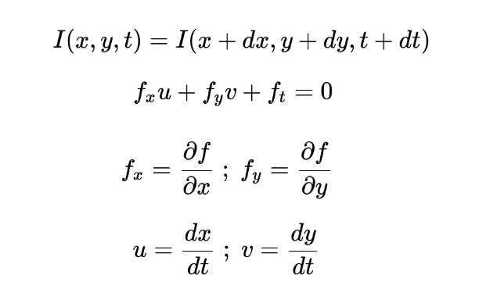
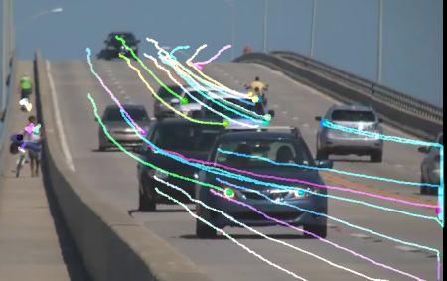
Feature Tracking
Notes:
sasasasasasasasasassasasas

Slide 28
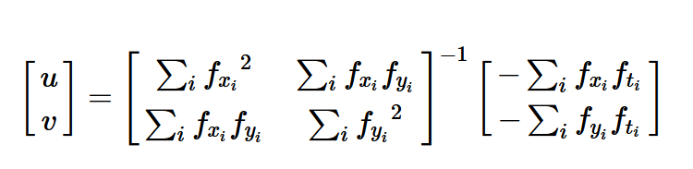
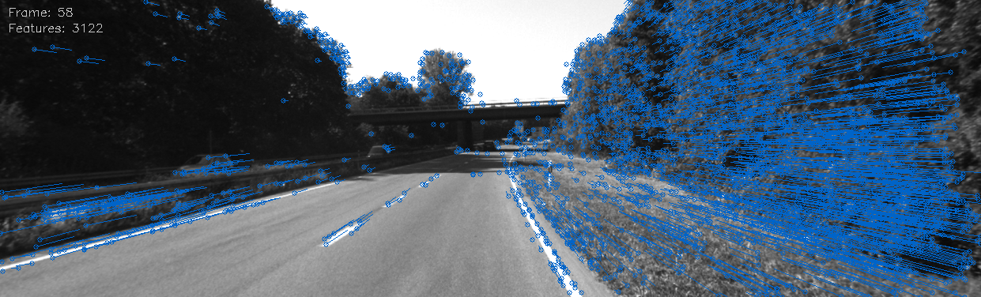
Lucas-Kanade Method

Slide 29

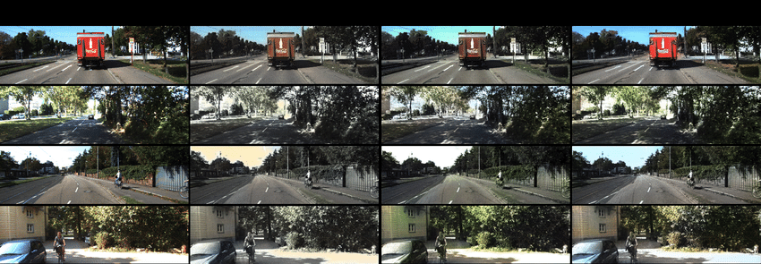



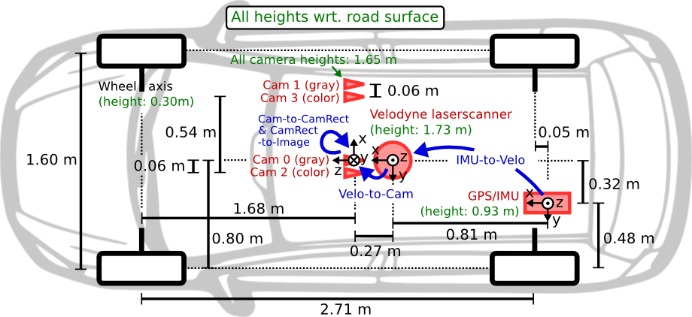


Software Tools & Dataset
Notes:
sa
sa
sa
sa

Slide 30
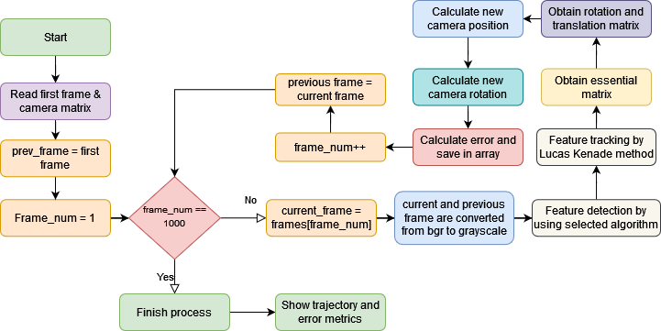
Algorithm
Notes:
After the algorithm and tools were selected we designed an algorithm. Its flow diagram here by detailed. This algorithm read camera position matrix and reads all frames seperately. First of all, converts bgr frame to gray, after that features detect by using selected algorithm. Later these features track by using lucas kenade method. After that Essential matrix obtain. By using essential matrix, rotation and translation matrix can be found. So, Relative position and rotation between two frames are found. By adding this position and rotation to the previous ones, instant rotation and position estimation is made.

Slide 31
RESULTS AND EVALUATION
Plotted Metrics
translation error for every dimension(x,y,z) at every frame
current euclidean distance of error(x,z) at every total traveled distance
current euclidean distance of error(x,z) at every frame
current euclidean distance of error over every total traveled distance at every frame
calculated trajectory and ground truth trajectory
Calculated Metrics
root-mean-square error
average error per frame
average error per meter

Slide 32
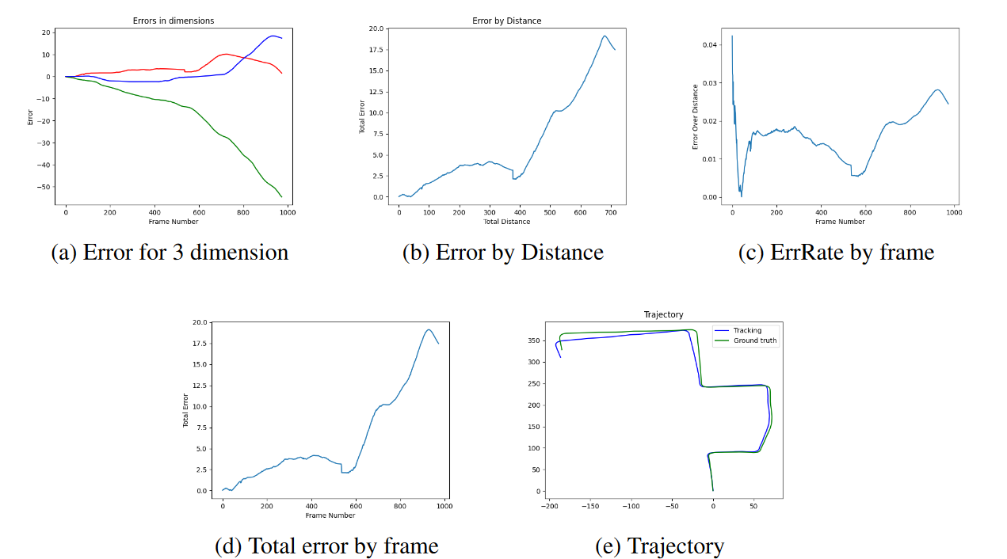
First Trajectory Results with FAST

Slide 33
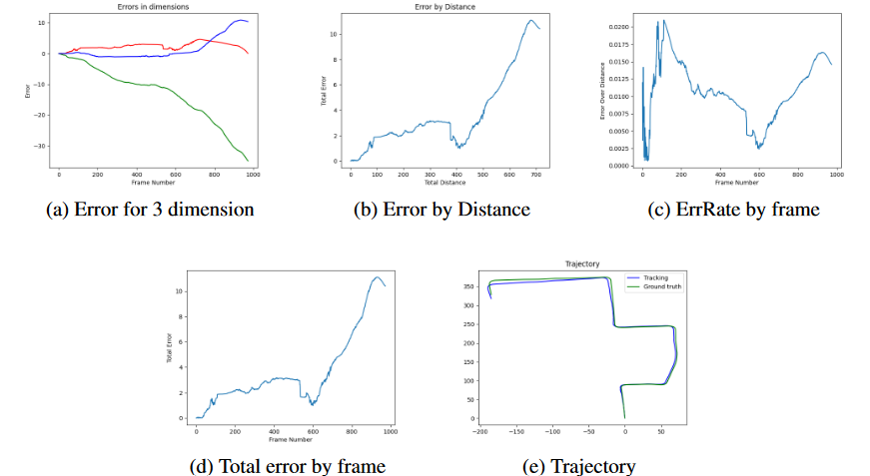
First Trajectory Results with GFTT

Slide 34
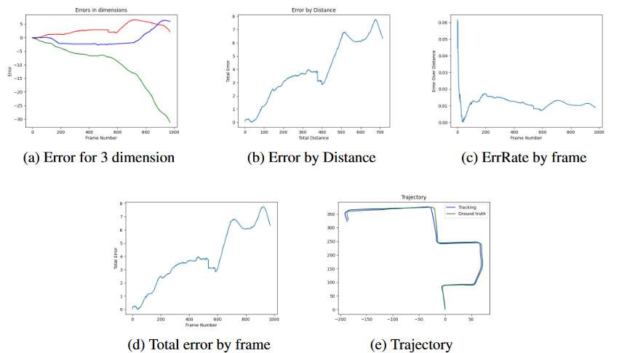
First Trajectory Results with SIFT

Slide 35
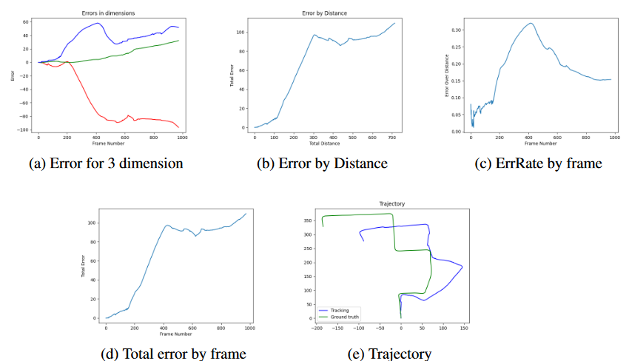
First Trajectory Results with ORB

Slide 36
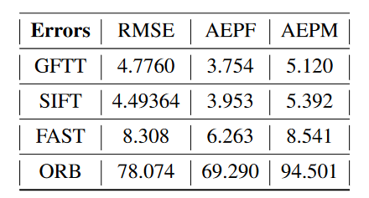
Calculated Errors

Slide 37
CONCLUSION
The use of Visual Odometry algorithms with traditional methods can give satisfactory results, especially when integrated with other sensors other than the camera. However, unlike learning-based methods, it is more practical as it does not require high processing power and training process. However, it is impossible to achieve an effective result in high or low light conditions or when feature extraction is not possible. For this reason, it is necessary to work on learning-based methods.

Slide 38
REFERENCES
[1] O. Ibrahim, Extended KalmanFilterSimultaneousLocalizationandMapping
(GraduationProject), 072011.
[2] M. Aqel,M.H.Marhaban,M.I.Saripan,andN.Ismail,“Reviewofvisual
odometry: types,approaches,challenges,andapplications,” SpringerPlus,
vol.5,122016.
[3] M. He,C.Zhu,Q.Huang,B.Ren,andJ.Liu,“Areviewofmonocularvisual
odometry,” The VisualComputer, vol.36,052020.
[4] D. Wu,“Robotlocalizationbasedonvisualodometry,”in Proceedingsofthe2017
5th InternationalConferenceonMachinery,MaterialsandComputing
Technology(ICMMCT2017). AtlantisPress,2017/04,pp.37–44.
[Online]. Available:https://doi.org/10.2991/icmmct-17.2017.9
[5] W.Zhao,S.Liu,Y.Shu,andY.-J.Liu,“Towardsbettergeneralization:Joint
depth-pose learningwithoutposenet,”2021.
[6] A. Geiger,P.Lenz,andR.Urtasun,“Arewereadyforautonomousdriving?thekitti
vision benchmarksuite,”in ConferenceonComputerVisionandPattern
Recognition(CVPR), 2012.

Slide 39
THANK YOU
07.02.2022

